Slide 1
Face Detection
Dec. 12th 2017
Wenhao Song
Jian Yang
Siyan Lin

Slide 2
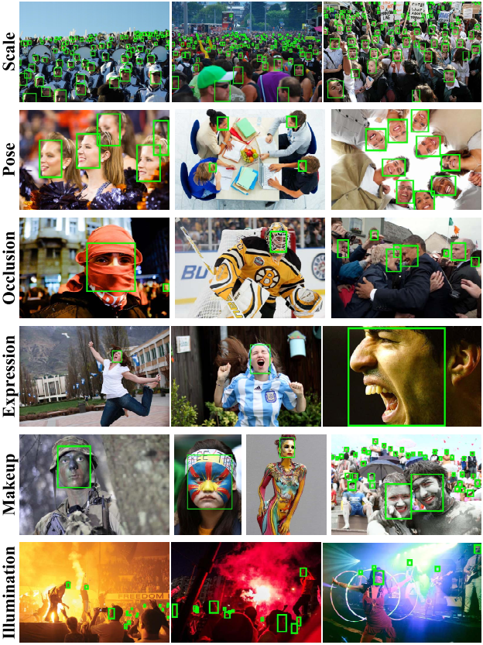
Motivation and Challenges
Problem
Detect various faces from background
Motivation
Automatic camera focus
Easier photo tagging
First step in any face recognition algorithm
Challenges
Different scales
Different poses (orientation)
Occlusion and makeup
Different expressions
Different illumination
Efficiency

Slide 3
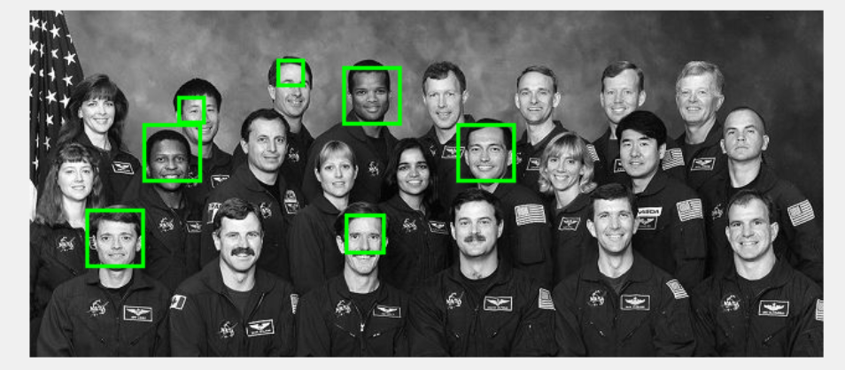
Evaluation
Same as PASCAL VOC dataset
If the ratio of the intersection of a detected region with an annotated face region is greater than 0.5, a score of 1 is assigned to the detected region, and 0 otherwise.
A Precision-Recall curve will be generated.

Slide 4
Final Goal
Use current approach (HOG+SVM) as a multiscale proposal and feed it into a detection network for final results.

